Slide 1
Introduction to Deep Learning
Dr Deepayan Bhowmik
Slides are adopted from Param Vir Singh, Carnegie Mellon and David Corn, Heriot-Watt

Slide 2

Recommended reading
Dive into Deep Learning
Aston Zhang, Zachary C. Lipton, Mu Li, and Alexander J. Smola
https://d2l.ai/ (Free download)

Slide 3
The bottom line
“Deep Learning doesn’t do different things,
it does things differently”
DL is providing breakthrough results in speech recognition and image classification …

Slide 4
Performance vs Sample Size
Deep Learning algorithms
Performance
Traditional ML algorithms
Size of Data

Slide 5

Supervised Learning
Traditional pattern recognition models work with hand crafted features and relatively simple trainable classifiers.
Limitations
Very tedious and costly to develop hand crafted features.
The hand-crafted features are usually highly dependents on one application.
Trainable Classifier
(e.g. SVM, Random Forrest)
Extract Hand Crafted Features
Output
(e.g. Outdoor Yes or No)

Slide 6




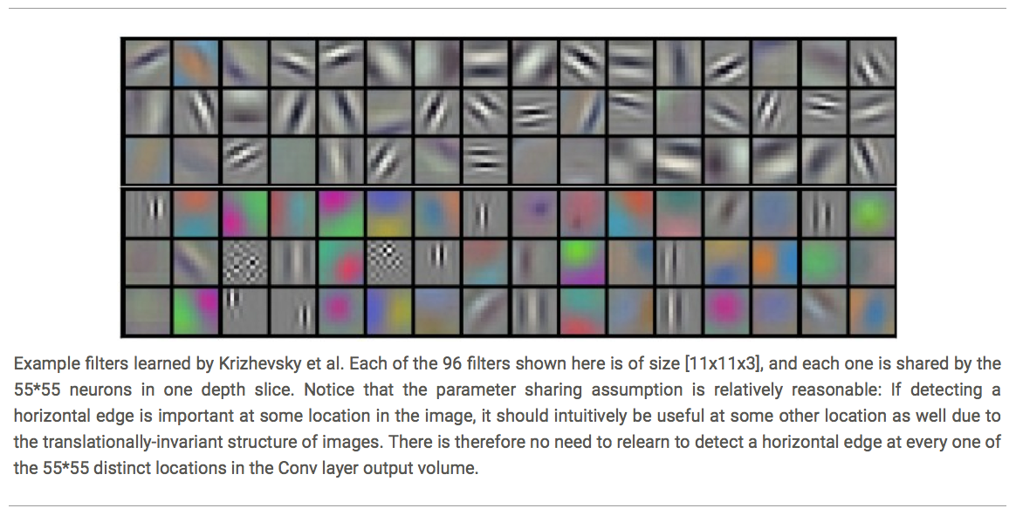
















Deep Learning
Deep learning has an inbuilt automatic multi stage feature learning process that learns rich hierarchical representations (i.e. features).
Low Level Features
Mid Level Features
High Level Features
Trainable Classifier
Output
(e.g. outdoor, indoor)

Slide 7
Deep Learning
Image
Pixel → Edge → Texture → Motif → Part → Object
Text
Character → Word → Word-group → Clause → Sentence → Story
Each module in Deep Learning transforms its input representation into a higher-level one, in a way similar to human cortex.
Low Level Features
Mid Level Features
High Level Features
Trainable Classifier
Input
Output

Slide 8
Let us see how it all works!
What exactly is deep learning ?
Why is it generally better than other methods on image, speech and certain other types of data?

Slide 9
Let us see how it all works!
What exactly is deep learning ?
Why is it generally better than other methods on image, speech and certain other types of data?
The short answers
‘Deep Learning’ means using a neural network with several layers of nodes between input and output
The series of layers between input & output do feature identification and processing in a series of stages, just as our brains seem to.

Slide 10
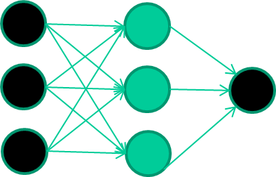
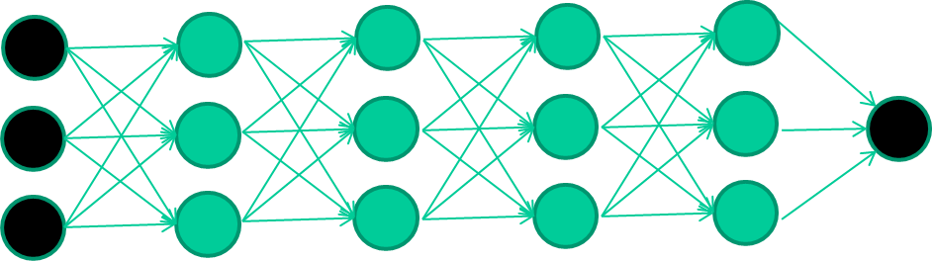
Let us see how it all works!
Multilayer neural networks have been around for 25 years. What’s actually new?
we have always had good algorithms for learning the
weights in networks with 1 hidden layer
but these algorithms are not good at learning the weights for
networks with more hidden layers
what’s new is: algorithms for training many-later networks

Slide 11
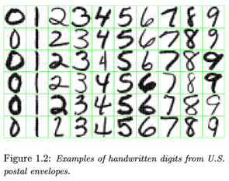
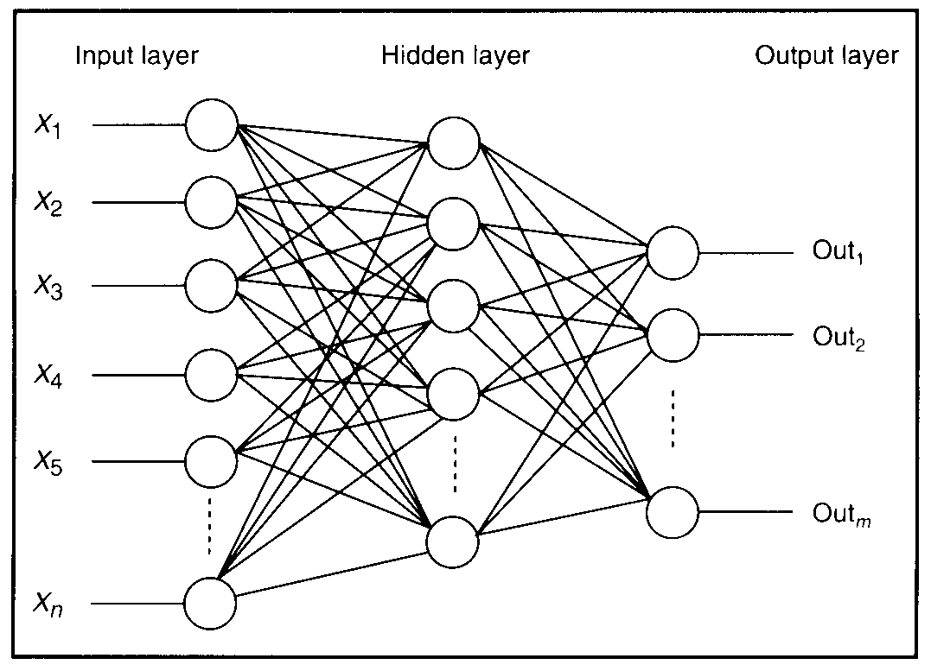
Feature detectors
Example of hand written digits by US postal department

Slide 12
what is this unit doing?

Slide 13
Hidden layer units become self-organised feature detectors
1 5 10 15 20 25 …
…
1
strong +ve weight
low/zero weight
63

Slide 14
What does this unit detect?
1 5 10 15 20 25 …
…
1
strong +ve weight
low/zero weight
63

Slide 15
What does this unit detect?
1 5 10 15 20 25 …
…
1
strong +ve weight
low/zero weight
it will send strong signal for a horizontal
line in the top row, ignoring everywhere else
63

Slide 16
What does this unit detect?
1 5 10 15 20 25 …
…
1
strong +ve weight
low/zero weight
63

Slide 17
What does this unit detect?
1 5 10 15 20 25 …
…
1
strong +ve weight
low/zero weight
Strong signal for a dark area in the top left
corner
63

Slide 18
What features might you expect a good NN
to learn, when trained with data like this?

Slide 19
vertical lines

Slide 20
Horizontal lines

Slide 21
Small circles
63

Slide 22
Small circles
But what about position invariance ??? our example unit detectors were tied to specific parts of the image

Slide 23
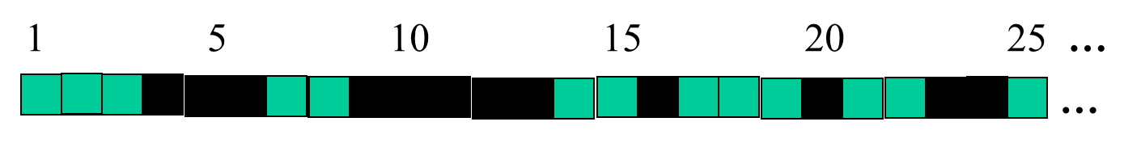
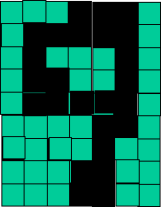
successive layers can learn higher-level features …
detect lines in
Specific positions
etc …
Higher level detetors
( horizontal line,
“RHS vertical lune”
“upper loop”, etc…
etc …
v

Slide 24
successive layers can learn higher-level features …
detect lines in
Specific positions
etc …
Higher level detetors
( horizontal line,
“RHS vertical lune”
“upper loop”, etc…
etc …
v
What does this unit detect?

Slide 25
So: multiple layers make sense

Slide 26
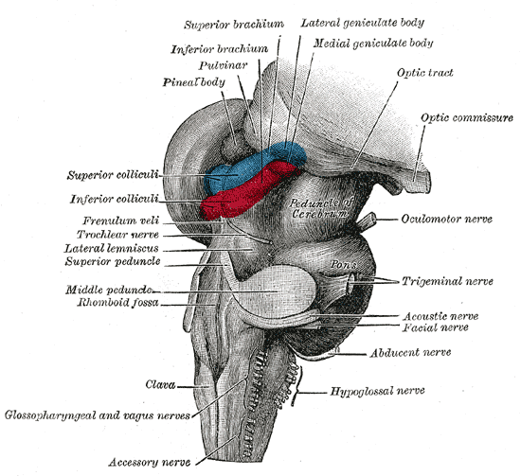
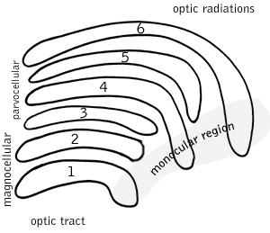
So: multiple layers make sense
Your brain works that way

Slide 27
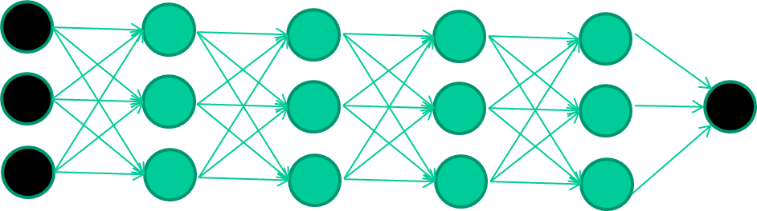
So: multiple layers make sense
Many-layer neural network architectures should be capable of learning the true underlying features and ‘feature logic’, and therefore generalise very well …

Slide 28
…. and then Deep Learning came along

Slide 29
The new way to train multi-layer NNs…

Slide 30
The new way to train multi-layer NNs…
Train this layer first

Slide 31
The new way to train multi-layer NNs…
Train this layer first
then this layer

Slide 32
The new way to train multi-layer NNs…
Train this layer first
then this layer
then this layer

Slide 33
The new way to train multi-layer NNs…
Train this layer first
then this layer
then this layer
then this layer

Slide 34
The new way to train multi-layer NNs…
Train this layer first
then this layer
then this layer
then this layer
finally this layer

Slide 35
The new way to train multi-layer NNs…
EACH of the (non-output) layers is trained to be an auto-encoder
Basically, it is forced to learn good features that describe what comes from the previous layer

Slide 36
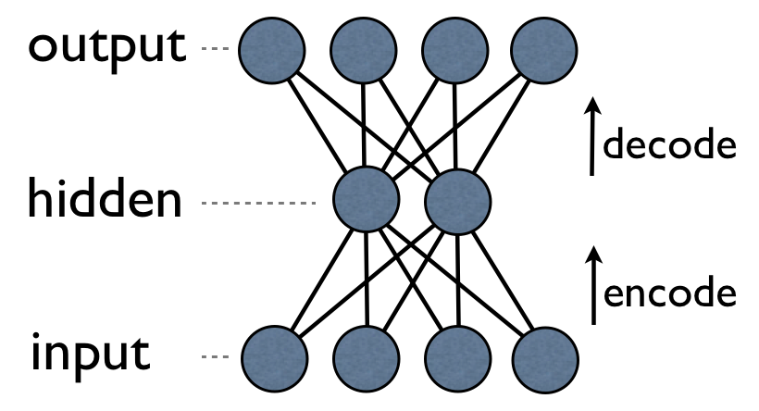
an auto-encoder is trained, with an absolutely standard weight-adjustment algorithm to reproduce the input

Slide 37
an auto-encoder is trained, with an absolutely standard weight-adjustment algorithm to reproduce the input
By making this happen with (many) fewer units than the inputs, this forces the ‘hidden layer’ units to become good feature detectors

Slide 38
Intermediate layers are each trained to be auto encoders (or similar)

Slide 39
Final layer trained to predict class based on outputs from previous layers

Slide 40
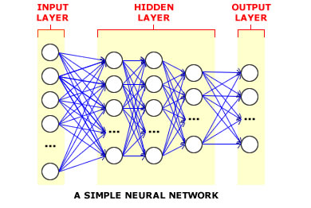
And that’s that
That’s the basic idea
There are many many types of deep learning,
different kinds of autoencoder, variations on architectures and training algorithms, etc…
Very fast growing area …

